Slide 1
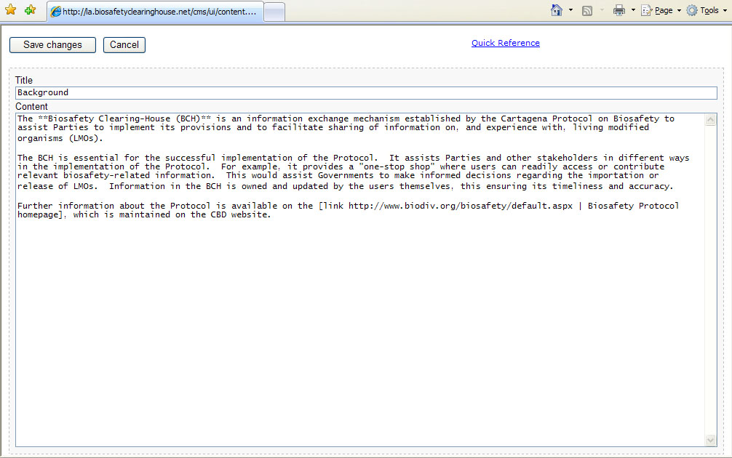
More Examples on Adding Modules
Using the content syntax:
For the last paragraph,[link http://www.biodiv.org/ biosafety/default.aspx | Biosafety Protocol homepage] will make the phrase “Biosafety Protocol homepage” a hyperlink.

Slide 2
More Examples on Adding Modules
Step 4. Then click on Save changes button to save. This will exit the user from the content editor and return to the index page of the NCBH
CLICK HERE

Slide 3
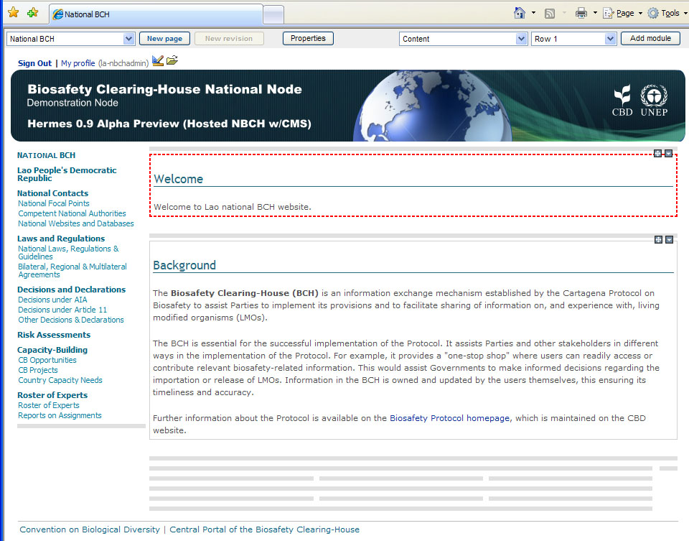
More Examples on Adding Modules

